Slide 1
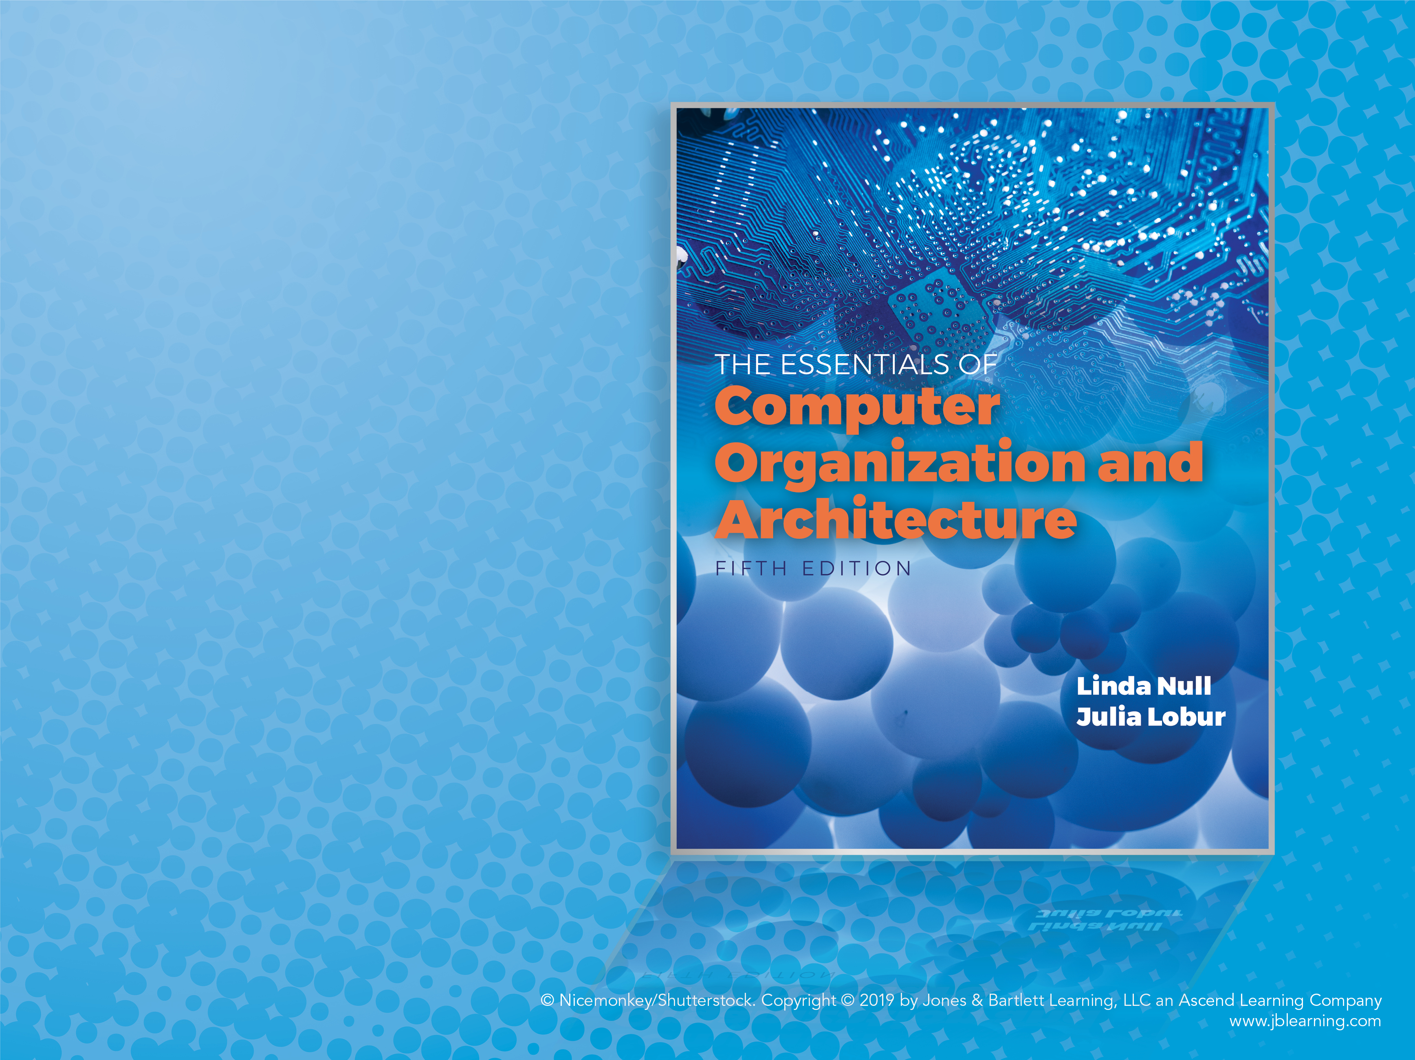
Chapter 9
Alternative Architectures

Slide 2

Objectives
Learn the properties that often distinguish RISC from CISC architectures.
Understand how multiprocessor architectures are classified.
Appreciate the factors that create complexity in multiprocessor systems.
Become familiar with the ways in which some architectures transcend the traditional von Neumann paradigm.

Slide 3
9.1 Introduction
We have so far studied only the simplest models of computer systems; classical single-processor von Neumann systems.
This chapter presents a number of different approaches to computer organization and architecture.
Some of these approaches are in place in today’s commercial systems. Others may form the basis for the computers of tomorrow.
Notes:
3

Slide 4
9.2 RISC Machines (1 of 9)
The underlying philosophy of RISC machines is that a system is better able to manage program execution when the program consists of only a few different instructions that are the same length and require the same number of clock cycles to decode and execute.
RISC systems access memory only with explicit load and store instructions.
In CISC systems, many different kinds of instructions access memory, making instruction length variable and fetch-decode-execute time unpredictable.
Notes:
4

Slide 5
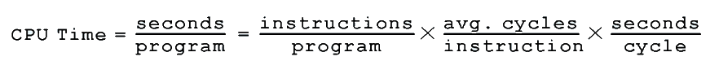
9.2 RISC Machines (2 of 9)
The difference between CISC and RISC becomes evident through the basic computer performance equation:
RISC systems shorten execution time by reducing the clock cycles per instruction.
CISC systems improve performance by reducing the number of instructions per program.
Notes:
5

Slide 6
9.2 RISC Machines (3 of 9)
The simple instruction set of RISC machines enables control units to be hardwired for maximum speed.
The more complex—and variable—instruction set of CISC machines requires microcode-based control units that interpret instructions as they are fetched from memory. This translation takes time.
With fixed-length instructions, RISC lends itself to pipelining and speculative execution.
Notes:
6

Slide 7
9.2 RISC Machines (4 of 9)
Consider the program fragments:
The total clock cycles for the CISC version might be:
(2 movs × 1 cycle) + (1 mul × 30 cycles) = 32 cycles
While the clock cycles for the RISC version is:
(3 movs × 1 cycle) + (5 adds × 1 cycle) + (5 loops × 1 cycle) = 13 cycles
With RISC clock cycle being shorter, RISC gives us much faster execution speeds.
mov ax, 0
mov bx, 10
mov cx, 5
Begin add ax, bx
loop Begin
mov ax, 10
mov bx, 5
mul bx, ax
CISC
RISC
Notes:
7

Slide 8
9.2 RISC Machines (5 of 9)
Because of their load-store ISAs, RISC architectures require a large number of CPU registers.
These registers provide fast access to data during sequential program execution.
They can also be employed to reduce the overhead typically caused by passing parameters to subprograms.
Instead of pulling parameters off of a stack, the subprogram is directed to use a subset of registers.
Notes:
8

Slide 9
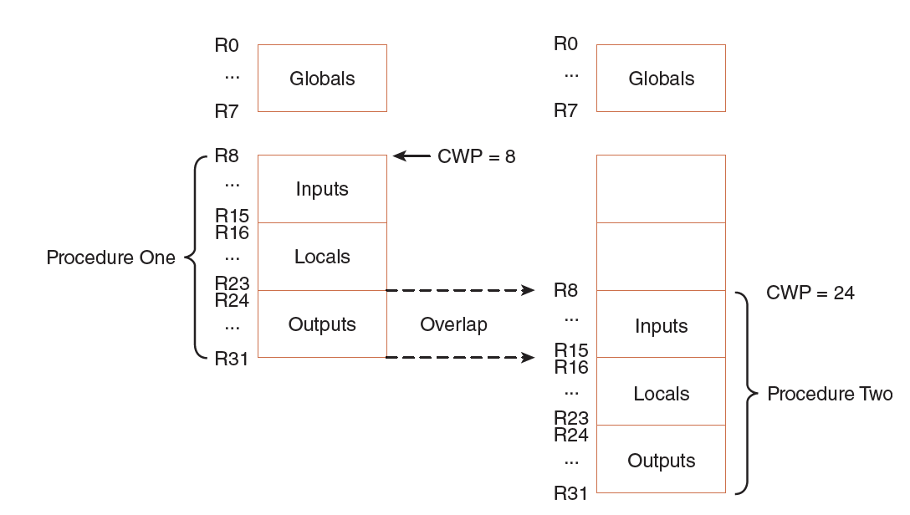
9.2 RISC Machines (6 of 9)
This is how registers can be overlapped in a RISC system.
The current window pointer (CWP) points to the active register window.
Notes:
9

Slide 10
9.2 RISC Machines (7 of 9)
It is becoming increasingly difficult to distinguish RISC architectures from CISC architectures.
Some RISC systems provide more extravagant instruction sets than some CISC systems.
Some systems combine both approaches.
The following two slides summarize the characteristics that traditionally typify the differences between these two architectures.
Notes:
10

Slide 11
9.2 RISC Machines (8 of 9)
CISC
Single register set
One or two register operands per instruction
Parameter passing through memory
Multiple cycle instructions
Microprogrammed control
Less pipelined
RISC
Multiple register sets
Three operands per instruction
Parameter passing through register windows
Single-cycle instructions
Hardwired
control
Highly pipelined
Notes:
11

Slide 12
9.2 RISC Machines (9 of 9)
CISC
Many complex instructions
Variable length instructions
Complexity in microcode
Many instructions can access memory
Many addressing modes
RISC
Simple instructions, few in number
Fixed length instructions
Complexity in compiler
Only LOAD/STORE instructions access memory
Few addressing modes
Notes:
12

Slide 13
9.3 Flynn’s Taxonomy (1 of 7)
Many attempts have been made to come up with a way to categorize computer architectures.
Flynn’s Taxonomy has been the most enduring of these, despite having some limitations.
Flynn’s Taxonomy takes into consideration the number of processors and the number of data paths incorporated into an architecture.
A machine can have one or many processors that operate on one or many data streams.
Notes:
13

Slide 14
9.3 Flynn’s Taxonomy (2 of 7)
The four combinations of multiple processors and multiple data paths are described by Flynn as:
SISD: Single instruction stream, single data stream. These are classic uniprocessor systems.
SIMD: Single instruction stream, multiple data streams. Execute the same instruction on multiple data values, as in vector processors.
MIMD: Multiple instruction streams, multiple data streams. These are today’s parallel architectures.
MISD: Multiple instruction streams, single data stream.
Notes:
14

Slide 15
9.3 Flynn’s Taxonomy (3 of 7)
Flynn’s Taxonomy falls short in a number of ways:
First, there appears to be no need for MISD machines.
Second, parallelism is not homogeneous. This assumption ignores the contribution of specialized processors.
Third, it provides no straightforward way to distinguish architectures of the MIMD category.
One idea is to divide these systems into those that share memory, and those that don’t, as well as whether the interconnections are bus-based or switch-based.
Notes:
15

Slide 16
9.3 Flynn’s Taxonomy (4 of 7)
Symmetric multiprocessors (SMP) and massively parallel processors (MPP) are MIMD architectures that differ in how they use memory.
SMP systems share the same memory and MPP do not.
An easy way to distinguish SMP from MPP is:
MPP ⇒ many processors + distributed memory + communication via network
SMP ⇒ fewer processors + shared memory + communication via memory
Notes:
16

Slide 17
9.3 Flynn’s Taxonomy (5 of 7)
Other examples of MIMD architectures are found in distributed computing, where processing takes place collaboratively among networked computers.
A network of workstations (NOW) uses otherwise idle systems to solve a problem.
A collection of workstations (COW) is a NOW where one workstation coordinates the actions of the others.
A dedicated cluster parallel computer (DCPC) is a group of workstations brought together to solve a specific problem.
A pile of PCs (POPC) is a cluster of (usually) heterogeneous systems that form a dedicated parallel system.
Notes:
17

Slide 18
9.3 Flynn’s Taxonomy (6 of 7)
Flynn’s Taxonomy has been expanded to include SPMD (single program, multiple data) architectures.
Each SPMD processor has its own data set and program memory. Different nodes can execute different instructions within the same program using instructions similar to:
If myNodeNum = 1 do this, else do that
Yet another idea missing from Flynn’s is whether the architecture is instruction driven or data driven.
The next slide provides a revised taxonomy.
Notes:
18

Slide 19
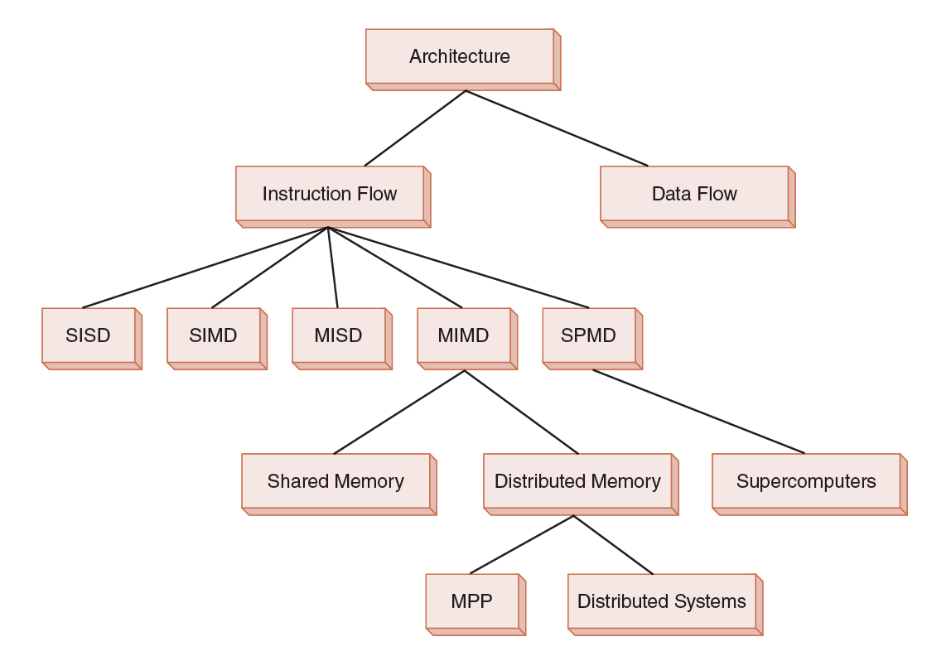
9.3 Flynn’s Taxonomy (7 of 7)
Notes:
19

Slide 20
9.4 Parallel and Multiprocessor Architectures (1 of 21)
Parallel processing is capable of economically increasing system throughput while providing better fault tolerance.
The limiting factor is that no matter how well an algorithm is parallelized, there is always some portion that must be done sequentially.
Additional processors sit idle while the sequential work is performed.
Thus, it is important to keep in mind that an n-fold increase in processing power does not necessarily result in an n-fold increase in throughput.
Notes:
20

Slide 21
9.4 Parallel and Multiprocessor Architectures (2 of 21)
Recall that pipelining divides the fetch-decode-execute cycle into stages that each carry out a small part of the process on a set of instructions.
Ideally, an instruction exits the pipeline during each tick of the clock.
Superpipelining occurs when a pipeline has stages that require less than half a clock cycle to complete.
The pipeline is equipped with a separate clock running at a frequency that is at least double that of the main system clock.
Superpipelining is only one aspect of superscalar design.
Notes:
21

Slide 22
9.4 Parallel and Multiprocessor Architectures (3 of 21)
Superscalar architectures include multiple execution units such as specialized integer and floating-point adders and multipliers.
A critical component of this architecture is the instruction fetch unit, which can simultaneously retrieve several instructions from memory.
A decoding unit determines which of these instructions can be executed in parallel and combines them accordingly.
This architecture also requires compilers that make optimum use of the hardware.
Notes:
22

Slide 23
9.4 Parallel and Multiprocessor Architectures (4 of 21)
Very long instruction word (VLIW) architectures differ from superscalar architectures because the VLIW compiler, instead of a hardware decoding unit, packs independent instructions into one long instruction that is sent down the pipeline to the execution units.
One could argue that this is the best approach because the compiler can better identify instruction dependencies.
However, compilers tend to be conservative and cannot have a view of the run time code.
Notes:
23

Slide 24
9.4 Parallel and Multiprocessor Architectures (5 of 21)
Vector computers are processors that operate on entire vectors or matrices at once.
These systems are often called supercomputers.
Vector computers are highly pipelined so that arithmetic instructions can be overlapped.
Vector processors can be categorized according to how operands are accessed.
Register-register vector processors require all operands to be in registers.
Memory-memory vector processors allow operands to be sent from memory directly to the arithmetic units.
Notes:
24

Slide 25
9.4 Parallel and Multiprocessor Architectures (6 of 21)
A disadvantage of register-register vector computers is that large vectors must be broken into fixed-length segments so they will fit into the register sets.
Memory-memory vector computers have a longer startup time until the pipeline becomes full.
In general, vector machines are efficient because there are fewer instructions to fetch, and corresponding pairs of values can be prefetched because the processor knows it will have a continuous stream of data.
Notes:
25

Slide 26
9.4 Parallel and Multiprocessor Architectures (7 of 21)
MIMD systems can communicate through shared memory or through an interconnection network.
Interconnection networks are often classified according to their topology, routing strategy, and switching technique.
Of these, the topology is a major determining factor in the overhead cost of message passing.
Message passing takes time owing to network latency and incurs overhead in the processors.
Notes:
26

Slide 27
9.4 Parallel and Multiprocessor Architectures (8 of 21)
Interconnection networks can be either static or dynamic.
Processor-to-memory connections usually employ dynamic interconnections. These can be blocking or nonblocking.
Nonblocking interconnections allow connections to occur simultaneously.
Processor-to-processor message-passing interconnections are usually static, and can employ any of several different topologies, as shown on the following slide.
Notes:
27

Slide 28
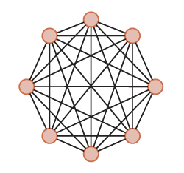
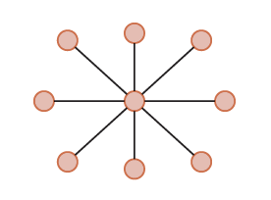
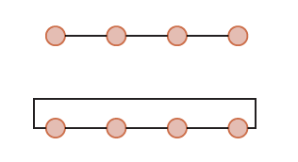
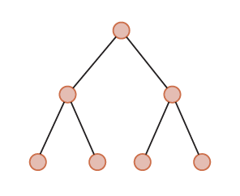
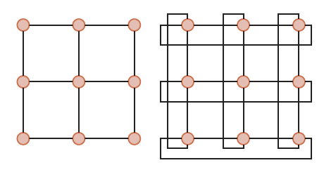
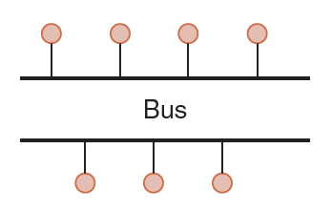
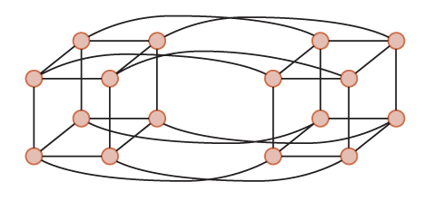
9.4 Parallel and Multiprocessor Architectures (9 of 21)
Completely Connected
Star
Linear and Ring
Tree
Mesh and Mesh Ring
Four-Dimensional Hypercube
A Bus-Based Network
Notes:
28

Slide 29
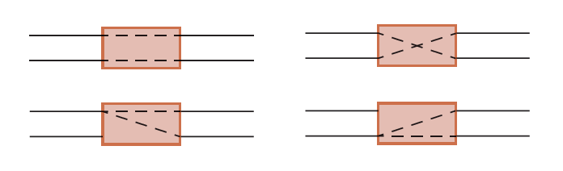
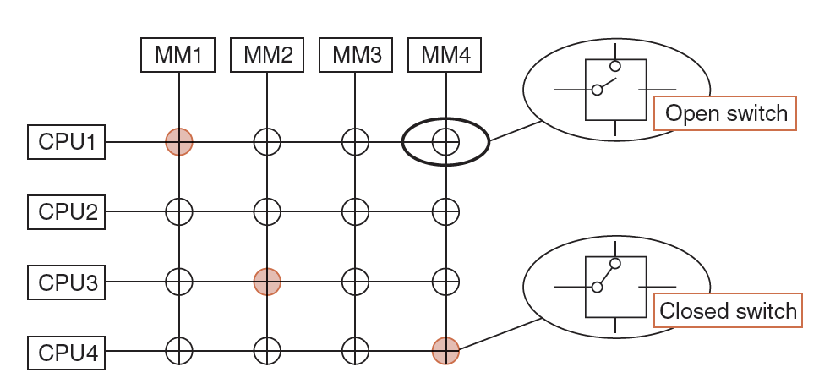
9.4 Parallel and Multiprocessor Architectures (10 of 21)
Dynamic routing is achieved through switching networks that consist of crossbar switches or 2 × 2 switches.
Through
Cross
Upper Broadcast
Lower Broadcast
Notes:
29

Slide 30
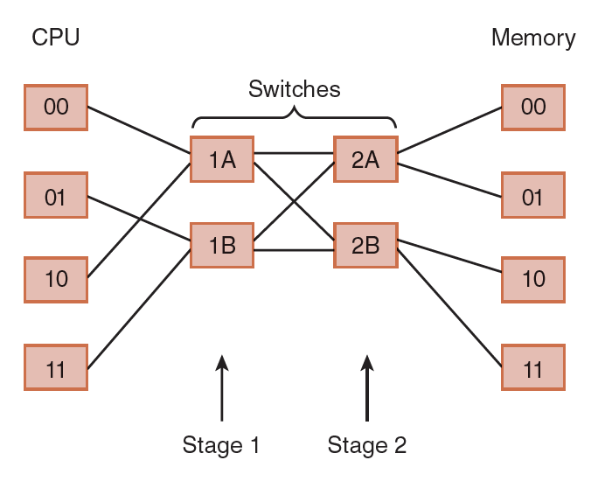
9.4 Parallel and Multiprocessor Architectures (11 of 21)
Multistage interconnection (or shuffle) networks are the most advanced class of switching networks.
They can be used in loosely-coupled distributed systems, or in tightly-coupled processor-to-memory configurations.
Notes:
30

Slide 31
9.4 Parallel and Multiprocessor Architectures (12 of 21)
There are advantages and disadvantages to each switching approach.
Bus-based networks, while economical, can be bottlenecks. Parallel buses can alleviate bottlenecks, but are costly.
Crossbar networks are nonblocking, but require n² switches to connect n entities.
Omega networks are blocking networks, but exhibit less contention than bus-based networks. They are somewhat more economical than crossbar networks, n nodes needing log₂n stages with n / 2 switches per stage.
Notes:
31

Slide 32
9.4 Parallel and Multiprocessor Architectures (13 of 21)
Tightly-coupled multiprocessor systems use the same memory. They are also referred to as shared memory multiprocessors.
The processors do not necessarily have to share the same block of physical memory.
Each processor can have its own memory, but it must share it with the other processors.
Configurations such as these are called distributed shared memory multiprocessors.
Notes:
32

Slide 33
9.4 Parallel and Multiprocessor Architectures (14 of 21)
Shared memory MIMD machines can be divided into two categories based upon how they access memory.
In uniform memory access (UMA) systems, all memory accesses take the same amount of time.
To realize the advantages of a multiprocessor system, the interconnection network must be fast enough to support multiple concurrent accesses to memory, or it will slow down the whole system.
Thus, the interconnection network limits the number of processors in a UMA system.
Notes:
33

Slide 34
9.4 Parallel and Multiprocessor Architectures (15 of 21)
The other category of MIMD machines are the nonuniform memory access (NUMA) systems.
While NUMA machines see memory as one contiguous addressable space, each processor gets its own piece of it.
Thus, a processor can access its own memory much more quickly than it can access memory that is elsewhere.
Not only does each processor have its own memory, it also has its own cache, a configuration that can lead to cache coherence problems.
Notes:
34

Slide 35
9.4 Parallel and Multiprocessor Architectures (17 of 21)
When a processor’s cached value is updated concurrently with the update to memory, we say that the system uses a write-through cache update protocol.
If the write-through with update protocol is used, a message containing the update is broadcast to all processors so that they may update their caches.
If the write-through with invalidate protocol is used, a broadcast asks all processors to invalidate the stale cached value.
Notes:
35

Slide 36
9.4 Parallel and Multiprocessor Architectures (18 of 21)
Write-invalidate uses less bandwidth because it uses the network only the first time the data is updated, but retrieval of the fresh data takes longer.
Write-update creates more message traffic, but all caches are kept current.
Another approach is the write-back protocol that delays an update to memory until the modified cache block must be replaced.
At replacement time, the processor writing the cached value must obtain exclusive rights to the data. When rights are granted, all other cached copies are invalidated.
Notes:
36

Slide 37
9.4 Parallel and Multiprocessor Architectures (19 of 21)
Distributed computing is another form of multiprocessing. However, the term distributed computing means different things to different people.
In a sense, all multiprocessor systems are distributed systems because the processing load is distributed among processors that work collaboratively.
The common understanding is that a distributed system consists of very loosely-coupled processing units.
Recently, NOWs have been used as distributed systems to solve large, intractable problems.
Notes:
37

Slide 38
9.4 Parallel and Multiprocessor Architectures (20 of 21)
For general-use computing, the details of the network and the nature of the multiplatform computing should be transparent to the users of the system.
Remote procedure calls (RPCs) enable this transparency. RPCs use resources on remote machines by invoking procedures that reside and are executed on the remote machines.
RPCs are employed by numerous vendors of distributed computing architectures including the Common Object Request Broker Architecture (CORBA) and Java’s Remote Method Invocation (RMI).
Notes:
38

Slide 39
9.4 Parallel and Multiprocessor Architectures (21 of 21)
Cloud computing is distributed computing to the extreme.
It provides services over the Internet through a collection of loosely-coupled systems.
In theory, the service consumer has no awareness of the hardware, or even its location.
Your services and data may even be located on the same physical system as that of your business competitor.
The hardware might even be located in another country.
Security concerns are a major inhibiting factor for cloud computing.
Notes:
39

Slide 40
9.5 Alternative Parallel Processing Approaches (1 of 15)
Some people argue that real breakthroughs in computational power—breakthroughs that will enable us to solve today’s intractable problems— will occur only by abandoning the von Neumann model.
Numerous efforts are now underway to devise systems that could change the way that we think about computers and computation.
In this section, we will look at three of these: dataflow computing, neural networks, and systolic processing.
Notes:
40

Slide 41
9.5 Alternative Parallel Processing Approaches (2 of 15)
Von Neumann machines exhibit sequential control flow: A linear stream of instructions is fetched from memory, and they act upon data.
Program flow changes under the direction of branching instructions.
In dataflow computing, program control is directly controlled by data dependencies.
There is no program counter or shared storage.
Data flows continuously and is available to multiple instructions simultaneously.
Notes:
41

Slide 42
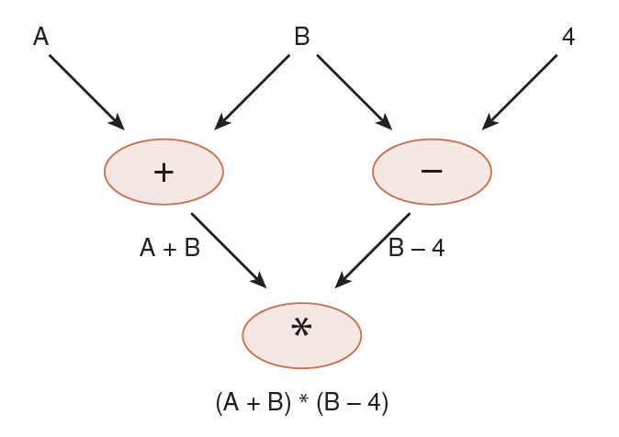
9.5 Alternative Parallel Processing Approaches (3 of 15)
A data flow graph represents the computation flow in a dataflow computer.
Its nodes contain the instructions and its arcs indicate the data dependencies.
Notes:
42

Slide 43
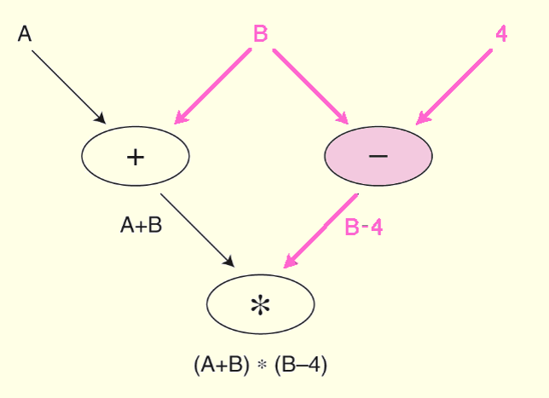
9.5 Alternative Parallel Processing Approaches (4 of 15)
When a node has all of the data tokens it needs, it fires, performing the required operation, and consuming the token.
The result is placed on an output arc.
Notes:
43

Slide 44
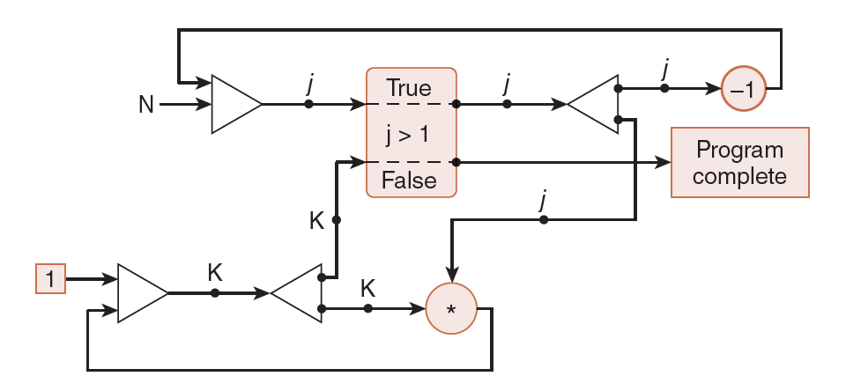
9.5 Alternative Parallel Processing Approaches (5 of 15)
A dataflow program to calculate N! and its corresponding graph are shown below.
(initial j <- n; k <- 1
while j > 1 do
new k<- * j;
new j <- j - 1;
return k)
Notes:
44

Slide 45
9.5 Alternative Parallel Processing Approaches (6 of 15)
The architecture of a dataflow computer consists of processing elements that communicate with one another.
Each processing element has an enabling unit that sequentially accepts tokens and stores them in memory.
If the node to which this token is addressed fires, the input tokens are extracted from memory and are combined with the node itself to form an executable packet.
Notes:
45

Slide 46
9.5 Alternative Parallel Processing Approaches (7 of 15)
Using the executable packet, the processing element’s functional unit computes any output values and combines them with destination addresses to form more tokens.
The tokens are then sent back to the enabling unit, optionally enabling other nodes.
Because dataflow machines are data driven, multiprocessor dataflow architectures are not subject to the cache coherency and contention problems that plague other multiprocessor systems.
Notes:
46

Slide 47
9.5 Alternative Parallel Processing Approaches (8 of 15)
Neural network computers consist of a large number of simple processing elements that individually solve a small piece of a much larger problem.
They are particularly useful in dynamic situations that are an accumulation of previous behavior, and where an exact algorithmic solution cannot be formulated.
Like their biological analogues, neural networks can deal with imprecise, probabilistic information, and allow for adaptive interactions.
Notes:
47

Slide 48
9.5 Alternative Parallel Processing Approaches (9 of 15)
Neural network processing elements (PEs) multiply a set of input values by an adaptable set of weights to yield a single output value.
The computation carried out by each PE is simplistic—almost trivial—when compared to a traditional microprocessor. Their power lies in their massively parallel architecture and their ability to adapt to the dynamics of the problem space.
Neural networks learn from their environments. A built-in learning algorithm directs this process.
Notes:
48

Slide 49
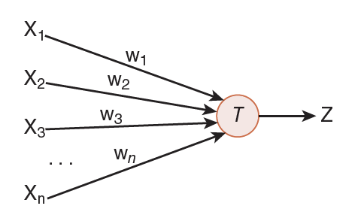
9.5 Alternative Parallel Processing Approaches (10 of 15)
The simplest neural net PE is the perceptron.
Perceptrons are trainable neurons. A perceptron produces a Boolean output based upon the values that it receives from several inputs.
Notes:
49

Slide 50
9.5 Alternative Parallel Processing Approaches (11 of 15)
Perceptrons are trainable because the threshold and input weights are modifiable.
In this example, the output Z is true (1) if the net input, w₁x₁ + w₂x₂ + . . .+ w_{n}x_{n} is greater than the threshold T.
Notes:
50

Slide 51
9.5 Alternative Parallel Processing Approaches (12 of 15)
Perceptrons are trained by use of supervised or unsupervised learning.
Supervised learning assumes prior knowledge of correct results, which are fed to the neural net during the training phase. If the output is incorrect, the network modifies the input weights to produce correct results.
Unsupervised learning does not provide correct results during training. The network adapts solely in response to inputs, learning to recognize patterns and structure in the input sets.
Notes:
51

Slide 52
9.5 Alternative Parallel Processing Approaches (13 of 15)
The biggest problem with neural nets is that when they consist of more than 10 or 20 neurons, it is impossible to understand how the net is arriving at its results. They can derive meaning from data that are too complex to be analyzed by people.
The U.S. military once used a neural net to try to locate camouflaged tanks in a series of photographs. It turned out that the nets were basing their decisions on the cloud cover instead of the presence or absence of the tanks.
Despite early setbacks, neural nets are gaining credibility in sales forecasting, data validation, and facial recognition.
Notes:
52

Slide 53
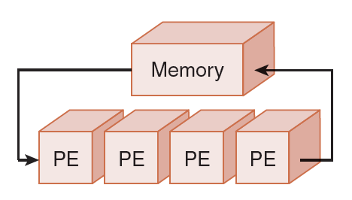
9.5 Alternative Parallel Processing Approaches (14 of 15)
Where neural nets are a model of biological neurons, systolic array computers are a model of how blood flows through a biological heart.
Systolic arrays, a variation of SIMD computers, have simple processors that process data by circulating it through vector pipelines.
Notes:
53

Slide 54
9.5 Alternative Parallel Processing Approaches (15 of 15)
Systolic arrays can sustain great throughout because they employ a high degree of parallelism.
Connections are short, and the design is simple and scalable. They are robust, efficient, and cheap to produce. They are, however, highly specialized and limited as to they types of problems they can solve.
They are useful for solving repetitive problems that lend themselves to parallel solutions using a large number of simple processing elements.
Examples include sorting, image processing, and Fourier transformations.
Notes:
54

Slide 55
9.6 Quantum Computing (1 of 8)
Computers, as we know them are binary, transistor-based systems.
But transistor-based systems strain to keep up with our computational demands.
We increase the number of transistors for more power, and each transistor smaller to fit on the die.
Transistors are becoming so small that it is hard for them to hold electrons in the way in which we're accustomed to.
Thus, alternatives to transistor-based systems are an active area or research.
Notes:
55

Slide 56
9.6 Quantum Computing (2 of 8)
Computers are now being built based on:
Optics (photonic computing)
Biological neurons
DNA
One of the most intriguing is quantum computers.
Quantum computing uses quantum bits (qubits) that can be in multiple states at once.
The “state” of a qubit is determined by the spin of an electron.
A thorough discussion of “spin” is under the domain of quantum physics.
Notes:
56

Slide 57
9.6 Quantum Computing (3 of 8)
A qubit can be in multiple states at the same time.
This is called superpositioning.
A 3-bit register can simultaneously hold the values 0 through 7.
8 operations can be performed at the same time.
This phenomenon is called quantum parallelism.
A system with 600 qbits can superposition 2600 states.
Notes:
57

Slide 58
9.6 Quantum Computing (4 of 8)
D-Wave Computers is the first quantum computer manufacturer.
D-Wave computers having 512 qbits were purchased separately by University of Southern California and Google for research purposes.
Quantum computers may be applied in the areas of cryptography, true random-number generation, and in the solution of other intractable problems.
Notes:
58

Slide 59
9.6 Quantum Computing (5 of 8)
Making effective use of quantum computers requires rethinking our approach to problems and the development of new algorithms.
To break a cypher, the quantum machine simulates every possible state of the problem set (i.e., every possible key for a cipher) and it “collapses” on the correct solution.
Examples include Schor’s algorithm for factoring products of prime numbers.
Many others remain to be discovered.
Notes:
59

Slide 60
9.6 Quantum Computing (6 of 8)
These systems are not constrained by a fetch-decode-execute cycle; however, quantum architectures have yet to settle on a definitive paradigm analogous to von Neumann systems.
Rose’s Law states that the number of qubits that can be assembled to successfully perform computations will double every 12 months; this has been precisely the case for the past 9 years.
This “law” is named after Geordie Rose, D-Wave’s founder and chief technology officer.
Notes:
60

Slide 61
9.6 Quantum Computing (7 of 8)
One of the largest obstacles to the progress of quantum computation is the tendency for qubits to decay into a state of decoherence.
Decoherence causes uncorrectable errors.
Advanced error-correction algorithms have been applied to this problem and show promise.
Much research remains to be done, however.
Notes:
61

Slide 62
9.6 Quantum Computing (8 of 8)
The realization of quantum computing has raised questions about technological singularity.
Technological singularity is the theoretical point when human technology has fundamentally and irreversibly altered human development.
This is the point when civilization changes to an extent that its technology is incomprehensible to previous generations.
Are we there, now?
Notes:
62

Slide 63
Conclusion (1 of 4)
The common distinctions between RISC and CISC systems include RISC’s short, fixed-length instructions. RISC ISAs are load-store architectures. These things permit RISC systems to be highly pipelined.
Flynn’s Taxonomy provides a way to classify multiprocessor systems based upon the number of processors and data streams. It falls short of being an accurate depiction of today’s systems.
Notes:
63

Slide 64
Conclusion (2 of 4)
Massively parallel processors have many processors, distributed memory, and computational elements communicate through a network. Symmetric multiprocessors have fewer processors and communicate through shared memory.
Characteristics of superscalar design include superpipelining, and specialized instruction fetch and decoding units.
Notes:
64

Slide 65
Conclusion (3 of 4)
Very long instruction word (VLIW) architectures differ from superscalar architectures because the compiler, instead of a decoding unit, creates long instructions.
Vector computers are highly-pipelined processors that operate on entire vectors or matrices at once.
MIMD systems communicate through networks that can be blocking or nonblocking. The network topology often determines throughput.
Notes:
65

Slide 66
Conclusion (4 of 4)
Multiprocessor memory can be distributed or exist in a single unit. Distributed memory brings to rise problems with cache coherency that are addressed using cache coherency protocols.
New architectures are being devised to solve intractable problems. These new architectures include dataflow computers, neural networks, systolic arrays, and quantum computers.
Notes:
66

